Slide 1
ChatApp API
By Team Freedom
Team Lead: Mengjie Zhao
Tech Lead: Yang Pan
Doc Lead: Hao Ding
Developer: Jialei Zhou, Yanshu Wei, Haoran Liang

Slide 2
Agenda
Use Case + GUI
View<=>Model Communication
API + UML
Design Pattern
Demo

Slide 3
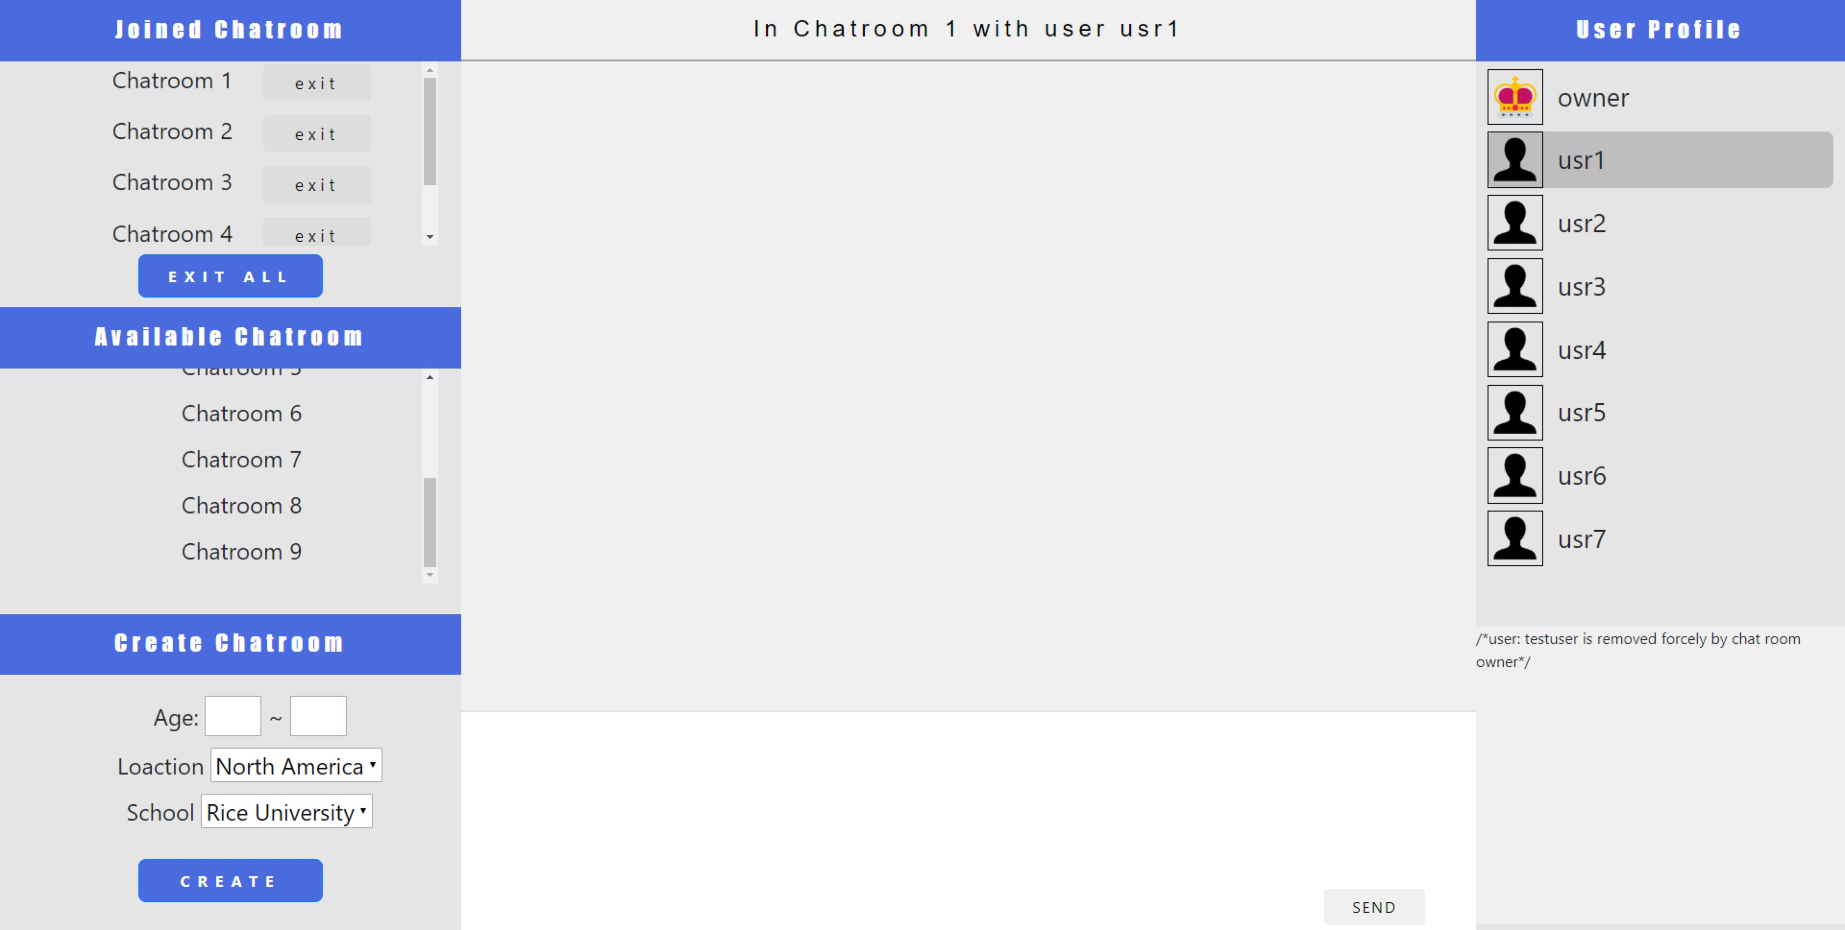
GUI Overview (Post user login)
Part 1
All rooms
Part 2
A Single Chat Room Info
& Message Box

Slide 4
Use Case & GUI Part 1
Joined rooms list
Users’ interaction with room
Exit/Exit All
Voluntarily – click “exit”
evicted – “hate” detected
Disconnected – close browser
Join – click room name
Qualification check
Create
Set qualification
Click “create”
All other rooms list
Create new room with qualification

Slide 5
GUI – From Part 1 to Part 2
Click the room name to show room info (room user list)
2. Click the username to open message box

Slide 6
Use Case & GUI Part 2
Display current user profile
User chat with others
Click “Send” to send message to another user
If the user is the owner of the room, the user will have the option to
Click “Send All” to send message to all users in the room
Click “Update Qualification” to change the room qualification
Left user status
Send Message

Slide 7
View<=>Model Communication
View is not updated every 100ms, but onevent
E.g. When receive a message from server
View will also have some logics to process the data from server to update the content it is presenting
Need to design the View<=>Model communication protocol for View and Model to interact

Slide 8
A Example
BACKEND MODEL
(2)Server onMessage
Determine command type – login
Create and store the user in backend
Notify view with below info
{
type : “login”,
res: gson.toJson(User)
}
username
FRONTEND VIEW
(1)Send to model “login user1 25 US Rice”
(3)View onMessage
Determine message type - login
Initialize the GUI based on returned User info - JSON.parse(message).res
User profile
User’s joined list, available list
etc
age
location
school
Login
Joined Chat Room List
Available Chat Room List
Freedom
…

Slide 9
Some communication protocol
We implemented some of below command types and it was easy!
Command type | View send | Model return
login | username age location school | {User Json}
createroom | roomname roomrulestring | {User Json} with one more room
joinroom | roomname | {User Json} with one room moved from available to joined
leaveroom | roomname | {User Json} with one room moved from joined to available
chat | roomname username msgstring | {ChatMsgHistory Json/arrya} with one more line of message
Etc | … | …

Slide 10
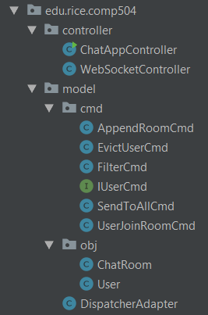
API + UML
Controller
ChatAppController
WebSocketController
Obj
ChatRoom
User
Cmd
5 commands
DispatcherAdapter

Slide 11
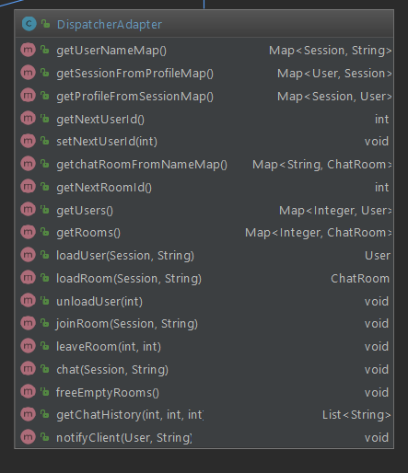
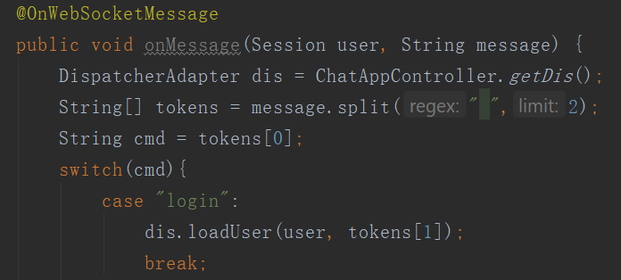
Dispatcher Adapter
The global storage for all chatrooms and sessions(users)
In HashMap
Functions called from WebSocketController to handle different input message processing from client
login msg, createroom msg, analogous to endpoint in 504 hw

Slide 12
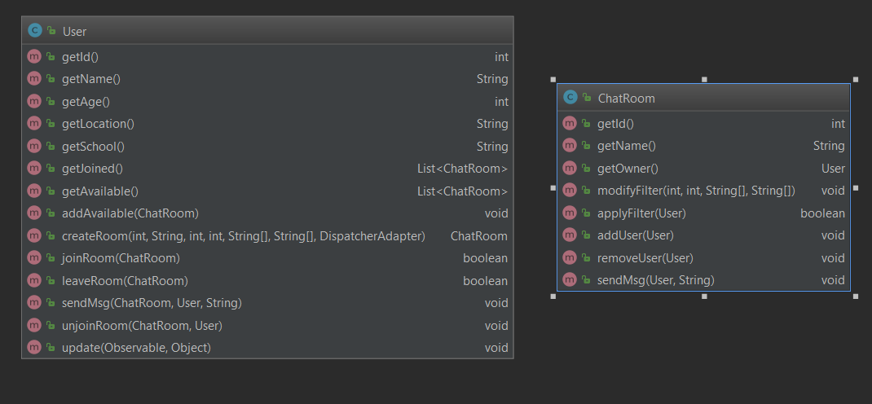
Obj
User’s info
Room’s info
Room’s Response to User Action
User’s Action

Slide 13
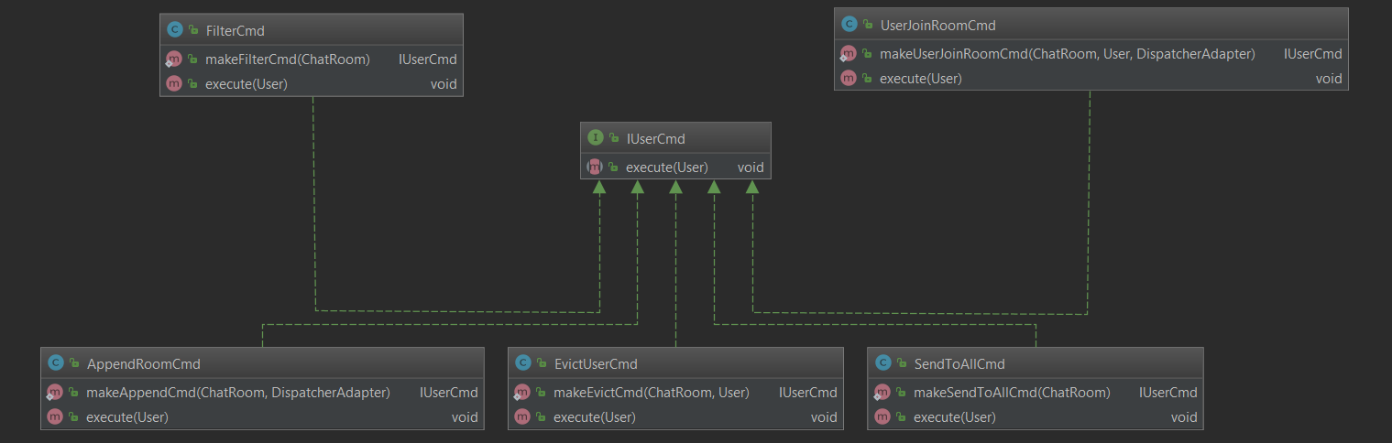
Cmd
Interface IUserCmd
execute() will operate on User & ChatRoom
Add new chatroom into user’s available chat room
Add/remove user(s) in a chatroom

Slide 14
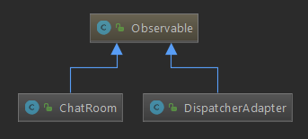
Design Pattern Part 1
Observable
Observer
User
Observable
Dispatcher
Dispatcher will notify all users when there is new chatroom
ChatRoom
ChatRoom will notify all users in the room when there are changes on the user list of the room

Slide 15
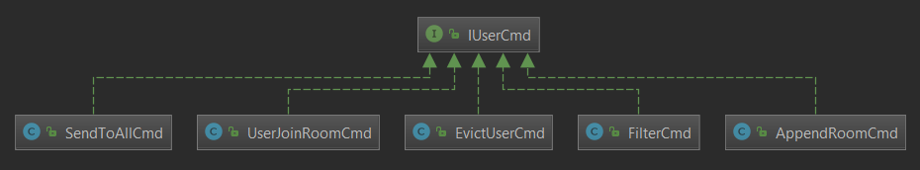
Design Pattern Part 2
Command
One command for each type observable’s notification
Dispatcher
AppendRoomCmd - A new room is created
ChatRoom
FilterCmd - Owner changes the room qualification
SendToAllCmd - Owner send a message to all users in the room
UserJoinRoomCmd - A new user join the room
EvictUserCmd - A existing user is evicted from the room

Slide 16
Demo

Slide 17
Q&A

